Slide 1
Te Aho o Te Kura Pounamu Connecting with communities for ākonga success
March 2024
Te Rina Leonard, Chief Executive
Oliver Kremesec, Information Resources
Michael Tompson, Deputy Chief Executive
www.tekura.school.nz

Slide 2
Te Aho o Te Kura Pounamu
Who we are

Slide 3
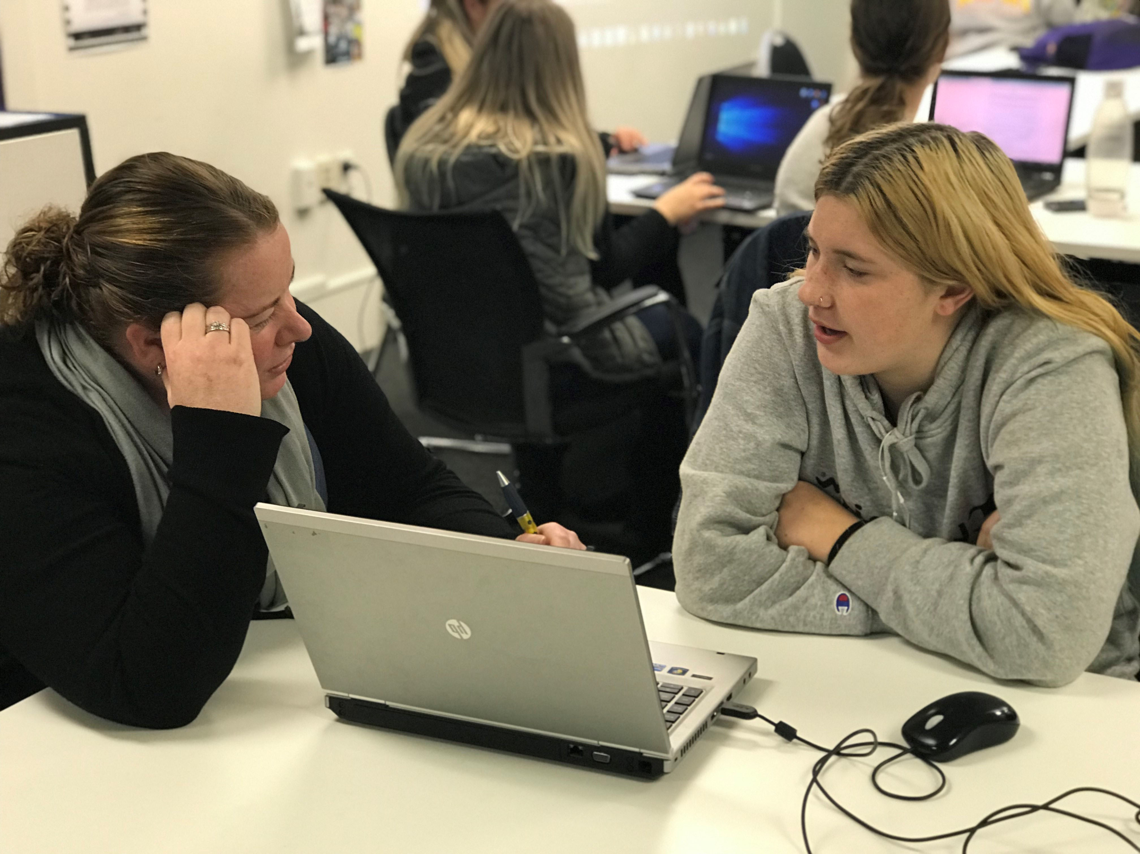
Te Kura – who we are
NZ’s state online distance education provider – around 900 kaimahi (staff) across 16 offices nationwide
Early childhood and Years 1-13
30,000~ students across a range of enrolment
gateways
Big Picture learning
Living Te Tiriti o Waitangi
Ensuring ākonga (students) are at the centre of everything we do

Slide 4
Big Picture Te Ara Pounamu – personalising learning for each akonga (student)
Authentic, personalised learning based on the needs, interests and
goals of each ākonga
He Whai Taumaru – Leaving to Learn and Careers
exploration – internships and shadowing
Learning experiences based on existing and emerging
interests
Huinga Ako – learning advisories where ākonga and kaiako (teachers)
meet to plan learning and engage (150-200 locations)

Slide 5
Personalised learning
Onboarding

Slide 6
Requirements for successful onboarding
Overall aim is for every ākonga to have a brilliant start to their learning
Understanding what each ākonga needs to succeed at Te Kura
from the moment they submit an enrolment application
Gathering information through ākonga voice:
personal experiences and preferences with learning
preferred language of instruction
whānau circumstances
wellbeing
preferred contact methods
learning support needs
supporting documentation or evidence from different agencies and education specialists located in one place
Requirements

Slide 7
Our end goal
A tool that is easy to use, easy to navigate, and easy to extend
Streamlined enrolment and kaimanaaki (learning advisor) allocation
process through a flag system, tick box checklists and notifications
rather than manual emails
Enables ākonga to quickly:
connect with kaimahi in their region
access My Te Kura, our secure online learning environment
find out about additional support they may be eligible for
Allows us to efficiently allocate ākonga to the correct enrolment
gateway/learning programme/Kaiako (teacher)
Results in targeted/increased support for those ākonga who need it in a more timely fashion
Future state: Access to aggregated data, which will support Te Kura to tell our story about the needs of our ākonga and to effectively advocate for them
Onboarding Tool

Slide 8
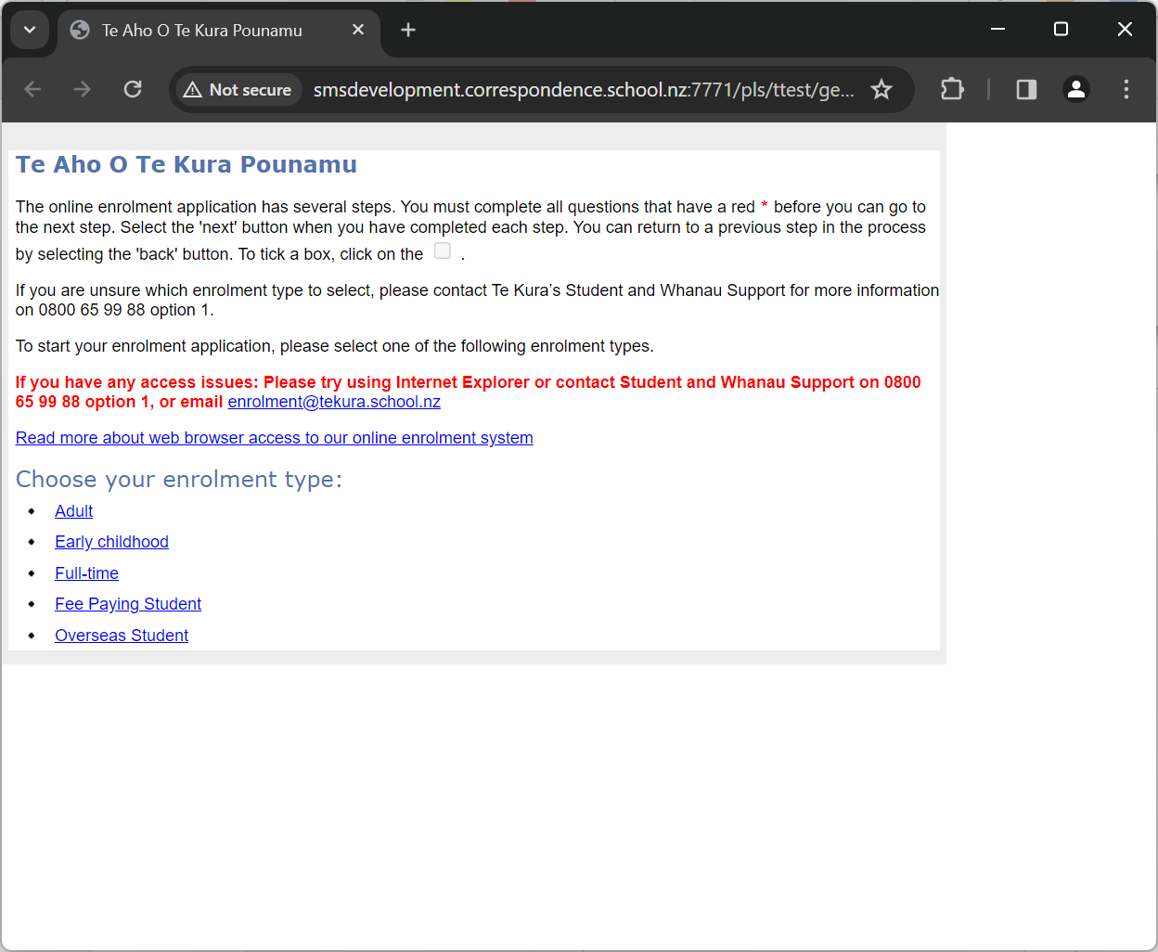
Where we’ve come from
Outdated traditional experience
Focused only on "administrative" information (i.e. fitting ITS/SMS)
No easy way to expand based on feedback from our Kaiako
Negative feedback

Slide 9
Demo – Applicant side
Simple graphical language
Dynamically lead the applicant through the process, even when they don’t know the answer to a question
“Guiding the student through the application process”
Notes:
Notes from Julian: video will auto-play. Can be talked over (it only demonstrates the simplicity of the tool and the dynamic aspects of the questions)

Slide 10
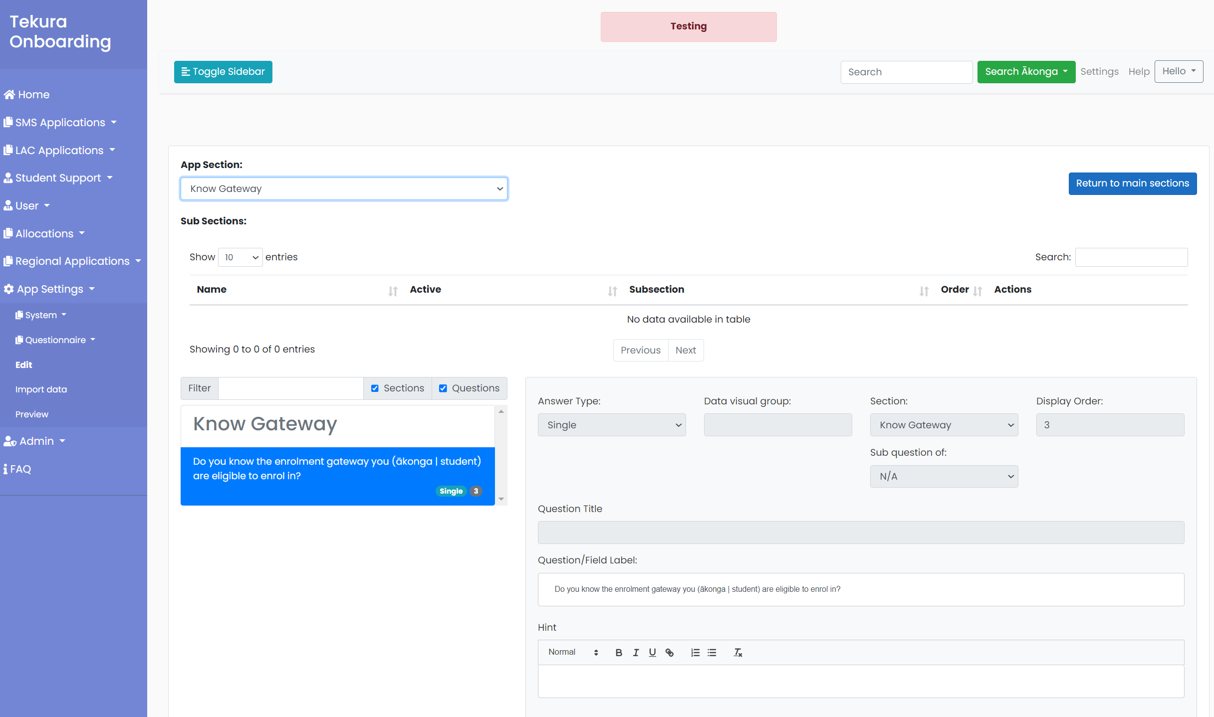
Fully customisable questionnaire
Dynamic reflex questions “creating a personalized set of next steps”
Directly in the hands of Te Kura users
Notes:
Notes from Julian: quick view of how questionaires are fully customisable.

Slide 11
Principle #1: Avoid blocking applicants
Notes:
Illustration of principle #1: Applicants can always continue and should not be blocked

Slide 12
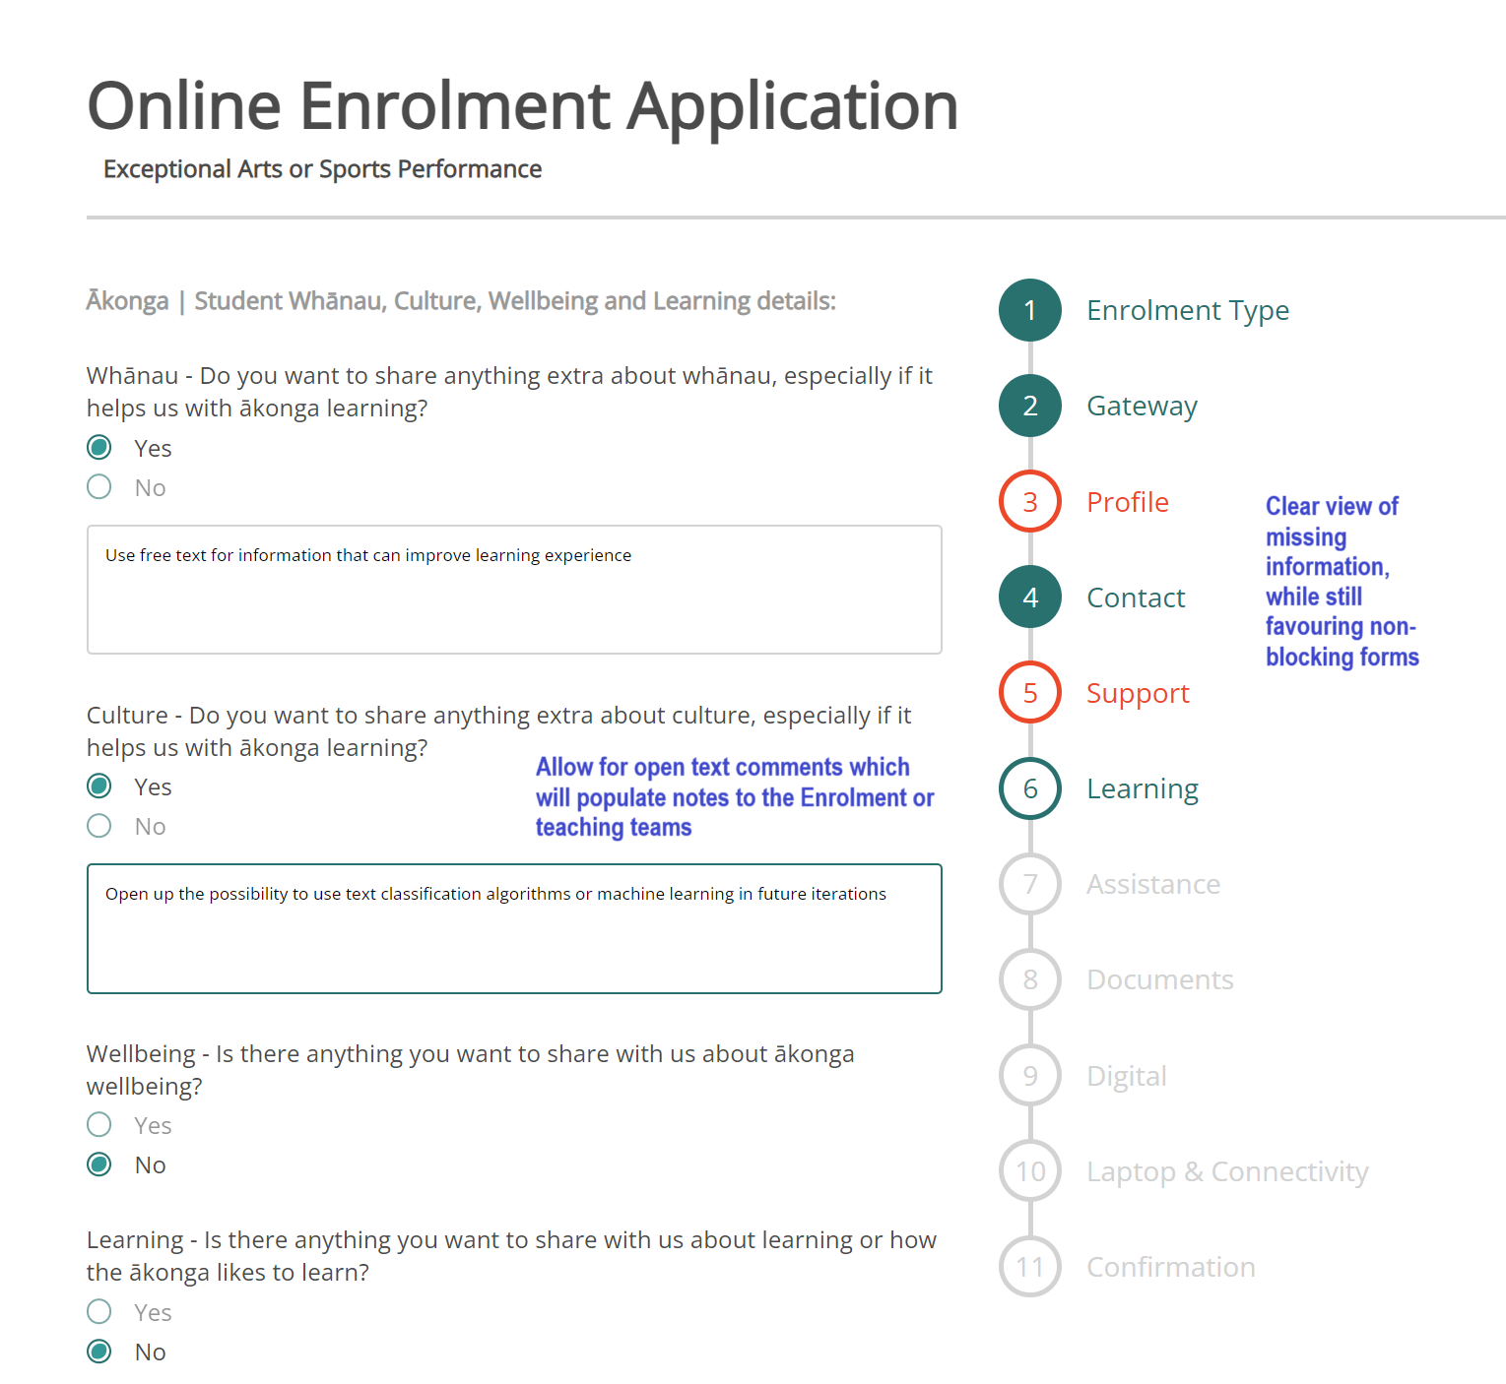
Principle #2: Let applicant tell you how they want to learn
Notes:
Notes from Julian: Shows how we favour free-text expression

Slide 13
Overview – Backend system
A simple flag system, driven by answers provided by ākonga:
- Green Good to go and automatically processed
- Purple Administrative information required, followed up by our Enrolment team
- Yellow Special attention required from our teaching teams
- Red Blocking or concerning elements, requiring contacting the student
Notes:
Notes from Julian: the video will auto-play and show what kaimahi see.

Slide 14
Behind the scenes
Full integration with ITS/SMS, including notes, student records, admission status
Full integration with other systems such as our Laptop and Connectivity subsidy program
Ability to process complete, partial, or complex enrolment applications seamlessly
Ability to perform tasks that ITS/SMS cannot, such as informing special staff even before admission
Staff friendly: what is ‘red’ or ‘yellow’ today may later be reassessed without IT intervention
Future proof: open text fields capture sentiments which cannot fit in a yes/no question
Agile and collaborative: we release constantly, open new gateways frequently, and change questions whenever we need to
Notes:
Notes from Julian: A quick view of our ‘hidden’ capabilities on the onboarding tool. Oliver can explain those domains if needed.

Slide 15
Personalised learning
Connecting with our ākonga

Slide 16
The E-waste environmental scene
Electronic waste currently constitutes 2-3% of municipal waste but is responsible for almost 70% of our toxic waste
Electronic waste is the fastest growing waste stream in NZ, estimated at 90,000 tonnes per annum
E-waste affects nearly every system in the human body due to a plethora of toxic components
A recent UK study shows that by extending the use of electronics for just 12 months, it is the equivalent of taking two million cars off the road

Slide 17
Te Kura Laptop and Connectivity programme
Through the Onboard tool we are able to determine which students are eligible for a laptop and internet connectivity bundle.
Through a partnership with Remark-IT we supply these inclusive with antivirus protection, anti-theft protection, dispatch and recovery, and ongoing support.
Te Kura’s supply chain is carbon neutral and is the largest operator of refurbished devices in New Zealand.
Our unit cost is 75% less than buying new devices, saving approximately $76M NZD or (836M Rand) of tax-payers’ money.

Slide 18
Te Kura’s digital approach
Our digital strategy and principles

Slide 19
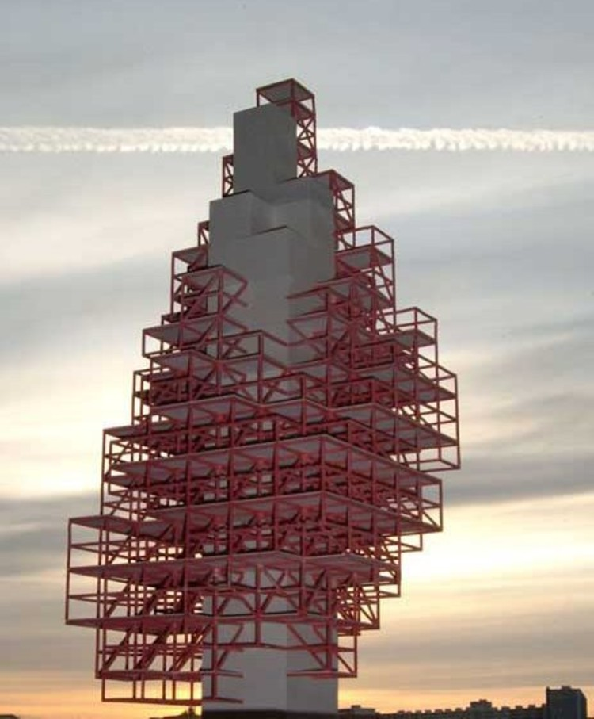
From skyscrapers to villages
Cyber & Network
Security
Identity
& Access
Mgmt
Cloud Infrast
Principles:
Deploy reusable and replaceable components (for example: Onboarding’s email service has been designed to address all email sending needs)
Technology agnostic – decoupled and connected where the value is in the data
Use industry standards, such as authentication, instead of re-implementing user management in every single application
Continuous evaluation and improvement of the component parts of the digital ecosystem (the village)
Back Office Systems
SMS
LMS (MTK)
Data Lake
3rd Party Apps
Office
Prod

Slide 20
Where we’ve come from and where we’re going
Lack of architecture principles
Legacy environment that relied on silos resulting in limited ability to change and evolve
Information was fragmented with no centralised views of ownership or proper measures of data quality
Solutions selected by individual teams rarely considered the 'big picture' and impact on others
Innovation through both users and technical teams
Artificially restraining what users can do or use, has led to them ‘finding ways around’, paradoxically increasing risk
Tech culture needed to change to embrace end-user innovation, but new modern foundations are required to support it
Cyber-resilience relies on both Security and Compliance
These two concepts have traditionally been kept separate, with Security understood as a technical responsibility, and Compliance a business responsibility
Today’s security risks emerge more often from users’ behaviour, and compliance issues from technically obsolete components

Slide 21
Waiho i te toipoto, kaua i te toiroa
Let us keep close together, not far apart
Email: terina.leonard@tekura.school.nz
Web: www.tekura.school.nz
Find us on Facebook and Instagram

